Slide 1
TCP Server

Slide 2
Content
TCP Server in Stream Socket
TCP Server APIs
Forking Server
Socket I/O Models

Slide 3
Content
TCP Server in Stream Socket
TCP Server APIs
Forking server
Socket I/O Models

Slide 4
TCP (Transmission Control Protocol)
Provide reliable communication
Data rate control
Example
  Mail
  WEB
  Image
server
client
SYN
SYN+ACK
ACK
Data

Slide 5
TCP Server
socket()‏
TCP client
bind()‏
socket()‏
listen()‏
connect()‏
establish
accept()‏
write()‏
data
read()‏
write()‏
data
read()‏
end
read()‏
close()‏
close()‏

Slide 6
TCP in Windows (Server side)
Create a socket – socket().
Bind the socket – bind().
Listen on the socket – listen().
Accept a connection – accept().
Send and receive data – recv(), send().
Disconnect – close().

Slide 7
Contents
TCP Server in Stream Socket
TCP Server APIs
Socket Mode
Socket I/O Models

Slide 8
Socket()
Returns value
  A new socket descriptor that you can use to do sockety things with
  If error occurs, return -1 (remember errno)
The domain is AF_INET, AF_INET6, or AF_UNSPEC, …
The type argument can be:
  SOCK STREAM: Establishes a virtual circuit for stream
  SOCK DGRAM: Establishes a datagram for communication
  SOCK SEQPACKET: Establishes a reliable, connection based, two way communication with maximum message size. (This isnot available on most machines.)
protocol is usually zero, so that type defines the connection within domain.
  #include <sys/types.h>
  #include <sys/socket.h>
  int socket(int domain, int type, int protocol);

Slide 9
bind()
Associate a socket with an IP address and port number
Where
  sockfd : is the socket id
  my_addr : is a pointer to the address family dependent address structure
  addrlen : is the size of *my_addr
Return value
  0 if no errors
  -1 if has errors
  #include <sys/types.h>
  #include <sys/socket.h>
  int bind(int sockfd, struct sockaddr *my_addr, socklen_t addrlen);

Slide 10
listen()
Establish a socket to listen for incoming connection.
s
  A descriptor identifying a bound, unconnected socket.
backlog
  The maximum length to which the queue of pending connections may grow.
Use after bind() with a port number
Return value
  0 if no errors
  - if has errors
#include <sys/socket.h>
int listen(int s, int backlog);

Slide 11
accept()
Accept an incoming connection on a listening socket
s
  A descriptor identifying a socket which is listening for connections after a listen().
addr
  An optional pointer to a buffer which receives the address of the connecting entity
  The format of the addr is determined by the address family
addrlen
  A optional pointer to an integer which contains the length of the address addr.
Return value
  Newly connected socket descriptor if no errors
  - if has errors
#include <sys/types.h>
#include <sys/socket.h>
int accept(int s, struct sockaddr *addr, socklen_t *addrlen);

Slide 12
send
Send data on a connected socket
s
  A descriptor identifying a connected socket.
buf
  A buffer containing the data to be transmitted.
len
  The length of the data in buff.
flags
  Specifies the way in which the call is made.
  Usually 0
Return value
  If no error occurs, send() returns the total number of characters sent
  Otherwise, return -1
#include <sys/types.h>
#include <sys/socket.h>
ssize_t send(int s, const void *buf, size_t len, int flags);

Slide 13
recv
Receive data on a socket
s
  A descriptor identifying a connected socket.
buf
  A buffer for the incoming data.
len
  The length of buf.
flags
  Specifies the way in which the call is made.
Return value
  If no error occurs, recv() returns the total number of characters received
  Otherwise, return -1
#include <sys/types.h>
#include <sys/socket.h>
ssize_t recv(int s, void *buf, size_t len, int flags);

Slide 14
close()
Close a socket descriptor
s
  A descriptor identifying a socket.
Return value
  If no error occurs, close() returns 0.
  Otherwise, return -1 (and errno will be set accordingly)
#include <unistd.h>
int close(int s);

Slide 15
Example
An simple example TCP server
  Create a socket()
  bind() its socket
  listen() TCP Client
  accept() the TCP client connection request
  close socket after client close session

Slide 16
Question
How could server accept another client after a client close its sesson?
What happened if there are two clients want to connect to Server ?

Slide 17
Content
TCP Server in Stream Socket
TCP Server APIs
Socket Mode
Socket I/O Models

Slide 18
Socket Mode
Types of server sockets
  Iterating server: Only one socket is opened at a time.
  Forking server: After an accept, a child process is forked off to handle the connection.
  Concurrent single server: use select to simultaneously wait on all open socketIds, and waking up the process only when new data arrives

Slide 19
Iterating server
Simple server
But when a client request can take longer to service, we can’t handle other clients
Use a concurrent server
The simplest way to write a concurrent server under Unix is to fork a child process to handle each client

Slide 20
fork
This function (including the variants of it provided by some systems) is the only way in Unix to create a new process.
It returns
  Once in the calling process (called the parent) with a return value that is the process ID of the newly created process (the child).
  Once in the child, with a return value of 0 (why?) → getpid
#include <unistd.h>
pid_t fork(void);

Slide 21
Use fork
pid_t pid;
int listenfd, connfd;
listenfd = Socket( ... );
/* fill in sockaddr_in{} with server's well-known port */
bind(listenfd, ... );
listen(listenfd, LISTENQ);
for ( ; ; ) {
  connfd = Accept (listenfd, ... ); /* probably blocks */
  if( (pid = Fork()) == 0) {
    Close(listenfd); /* child closes listening socket */
    doit(connfd); /* process the request */
    Close(connfd); /* done with this client */
    exit(0); /* child terminates */
  }
  Close(connfd); /* parent closes connected socket */
}

Slide 22
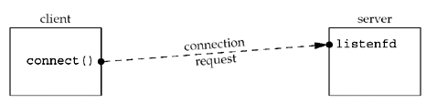
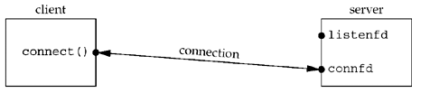
Iterative server vs forking server
Iterative server

Slide 23
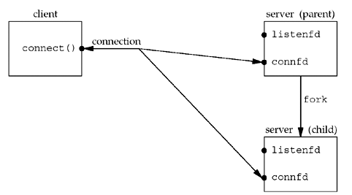
Iterative server vs forking server
forking server
X

Slide 24
Signaling
A signal is a notification to a process that an event has occurred.
Signals are sometimes called software interrupts.
Signals usually occur asynchronously. By this we mean that a process doesn't know ahead of time exactly when a signal will occur.
Signals can be sent
  By one process to another process (or to itself)
  By the kernel to a process

Slide 25
Signaling (2)
We set the disposition of a signal by calling the sigaction function (described shortly) and we have three choices for the disposition:
  We can provide a function that is called whenever a specific signal occurs. (signal handler)
  void handler (int signo);
  We can ignore a signal by setting its disposition to SIG_IGN
  We can set the default disposition for a signal by setting its disposition to SIG_DFL.

Slide 26
Normal Termination
We use forking server, when a child process end the connect with a client and terminate, it sends the SIGCHLD signal to the parent
If we ignore the SIGCHLD, the child process will enter the zombie state
We need to handle that signal

Slide 27
Handling SIGCHLD Signals
The purpose of the zombie state is to maintain information about the child for the parent to fetch at some later time.
This information includes the process ID of the child, its termination status, and information on the resource utilization of the child (CPU time, memory, etc.).
They take up space in the kernel and eventually we can run out of processes
Whenever we fork children, we must wait for them to prevent them from becoming zombies → establish a signal handler to catch SIGCHLD, and within the handler, we call wait
Establish the signal handler by adding the function call : Signal (SIGCHLD, sig_chld);

Slide 28
wait() and waitpid()
Use to handle the terminated child
Both return two values:
  The return value of the function is the process ID of the terminated child
  The termination status of the child (an integer) is returned through the statloc pointer.
#include <sys/wait.h>
pid_t wait (int *statloc);
pid_t waitpid (pid_t pid, int *statloc, int options);

Slide 29
tcpcliserv/sigchldwait.c
#include "unp.h"
void sig_chld(int signo)
{
pid_t pid;
int stat;
pid = wait(&stat);
printf("child %d terminated\", pid);
return;
}

Slide 30
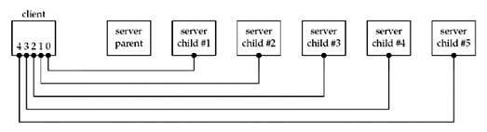
Difference between wait() and waitpid()
Create 5 connections from a client to a forking server
When the client terminates, all open descriptors are closed automatically by the kernel → five connections ended simultaneous

Slide 31
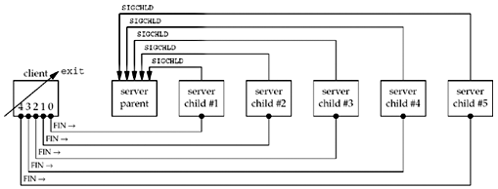
Difference between wait() and waitpid() (2)
Client terminates, closing all five connections, terminating all five children → four children are zombies
It can happen when many users connect to a server
→ we have to use waitpid()

Slide 32
tcpcliserv/sigchldwaitpid.c
#include "unp.h"
void sig_chld(int signo)
{
pid_t pid;
int stat;
while ( (pid = waitpid(-1, &stat, WNOHANG)) > 0)
printf("child %d terminated\n", pid);
return;
}

Slide 33
Others
Connection abort before accept return
  Client abort connection or reset
  Have errors → server could ignore and call accept again
Termination of server process
  Server end but client wait in fgets
  Use two descriptor : one for socket and one for user input
  Use select and poll
Crashing of sever host
Crashing and Reboot of server host

Slide 34
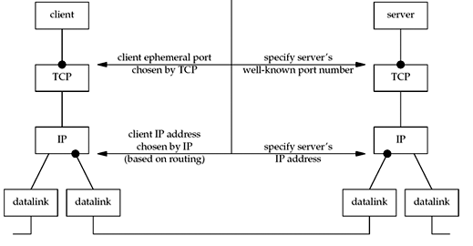
Summary of TCP – client side

Slide 35
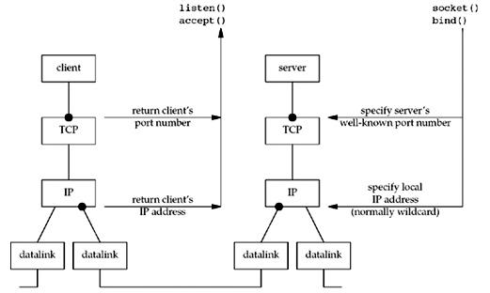
Summary of TCP – server side

Slide 36
Content
TCP Server in Stream Socket
TCP Server APIs
Forking server
Socket I/O Models

Slide 37
I/O Multiplexing
The basic differences in the five I/O models that are available
  blocking I/O
  nonblocking I/O
  I/O multiplexing (select and poll)
  signal driven I/O (SIGIO)
  asynchronous I/O (the POSIX aio_functions)

Slide 38
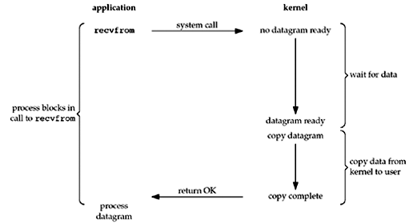
Blocking I/O Model

Slide 39
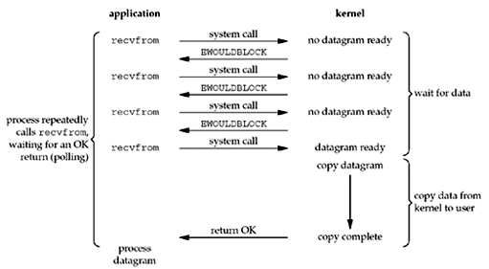
Nonblocking I/O Model

Slide 40
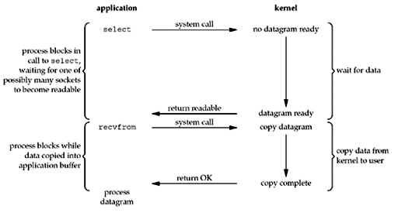
I/O Multiplexing Model

Slide 41
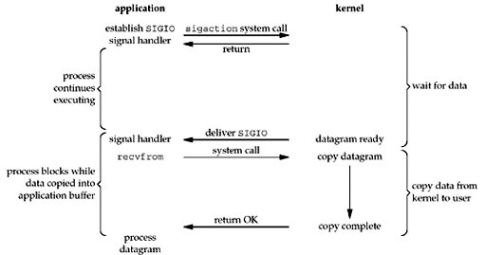
Signal-Driven I/O Model

Slide 42
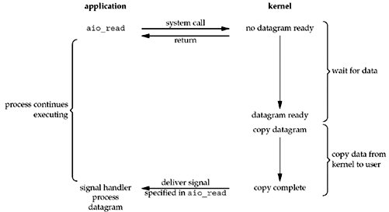
Asynchronous I/O Model

Slide 43
Asynchronous I/O Model (2)
We call aio_read (the POSIX asynchronous I/O functions begin with aio_)
Pass the kernel
  the descriptor
  buffer pointer
  buffer size (the same three arguments for read)
  buffer offset (similar to lseek)
  how to notify us when the entire operation is complete
This system call returns immediately and our process is not blocked while waiting for the I/O to complete.

Slide 44
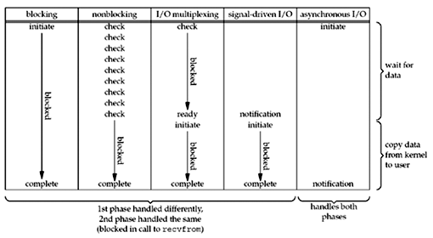
Comparison of the I/O Models

Slide 45
select() function
This function allows the process to instruct the kernel to wake up the process only when one or more of events occurs or when a specified amount of time has passed.
Exp : kernel to return only when
  {1, 4, 5} are ready for reading
  {2, 7} are ready for writing
  {1, 4} have an exception condition pending
  10.2 seconds have elapsed
The select() function gives you a way to simultaneously check multiple sockets to see if they have data waiting to be recv(), or if you can send() data to them without blocking, or if some exception has occurred.

Slide 46
select() function (2)
timeout is the time which tells the kernel how long to wait for one of the specified descriptors to become ready. There are three types of using timeout
  Wait forever
  Wait up to a fixed amount of time
  Do not wait at all : polling
a
#include <sys/select.h>
int select(int n, fd_set *readfds, fd_set *writefds,
fd_set *exceptfds, struct timeval *timeout);
ẻ
struct timeval {
long tv_sec; /* seconds */
long tv_usec; /* microseconds */
};

Slide 47
Examples
int s1, s2, n;
fd_set readfds;
struct timeval tv;
char buf1[256], buf2[256];
// pretend we've connected both to a server at this point
//s1 = socket(...); s2 = socket(...);
//connect(s1, ...)... connect(s2, ...)...
// clear the set ahead of time
FD_ZERO(&readfds);
// add our descriptors to the set
FD_SET(s1, &readfds);
FD_SET(s2, &readfds);
// since we got s2 second, it's the "greater", so we use that for
// the n param in select()
n = s2 + 1;

Slide 48
Examples (2)
// wait until either socket has data ready to be recv()d (timeout 10.5 secs)
tv.tv_sec = 10;
tv.tv_usec = 500000;
rv = select(n, &readfds, NULL, NULL, &tv);
if (rv == -1) {
perror("select"); // error occurred in select() }
else if (rv == 0)
{
printf("Timeout occurred! No data after 10.5 seconds.\n");
}
else {
// one or both of the descriptors have data
if (FD_ISSET(s1, &readfds)) {
recv(s1, buf1, sizeof buf1, 0); }
if (FD_ISSET(s2, &readfds)) {
recv(s1, buf2, sizeof buf2, 0); }
}

Slide 49
fd_set
Other fd_sets use to specify the descriptors that we want the kernel to test for reading, writing, and exception conditions.
To specify one or more descriptor values for each of these three arguments, select uses descriptor sets.
All the implementation details are irrelevant to the application and are hidden in the fd_set datatype and the following four macros:
Return value (select) :
  the number of descriptors in the set on success, 0 if the timeout was reached, or -1 on error
void FD_ZERO(fd_set *fdset); /* clear all bits in fdset */
void FD_SET(int fd, fd_set *fdset); /* turn on the bit for fd in fdset */
void FD_CLR(int fd, fd_set *fdset); /* turn off the bit for fd in fdset */
int FD_ISSET(int fd, fd_set *fdset); /* Return true if fd is in the fdset */

Slide 50
poll() function
Similar to select() but poll() provides additional information when dealing with STREAMS devices
The first argument is a pointer to the first element of an array of structures.
  Each element of the array is a pollfd structure
  The second argument is number of pollfd structure in fdarray
#include <poll.h>
int poll (struct pollfd *fdarray, unsigned long nfds, int timeout);

Slide 51
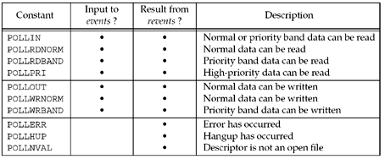
Pollfd structure
struct pollfd {
int fd; /* descriptor to check */
short events; /* events of interest on fd */
short revents; /* events that occurred on fd */ };
Input events and returned revents for poll
a

Slide 52
shutdown()
Stop further sends and receives on a socket
s is the socket we will stop
howto is the way we stop the socket (stop send or receive)
  SHUT_RD : stop receiving data
  SHUT_WR : stop sending data
  SHUT_RDWR : do SHUT_RD and then SHUT_WR
Return Value
  0 on success
  -1 on error
#include <sys/socket.h>
int shutdown(int s, int how);

Slide 53
Examples
In the reference book
  Select() server : section 6.8
  Poll() server : section 6.11

